Slide 1
ER to relational mapping
Company database

Slide 2
ER to Relational Database
After designing the ER diagram of system, we need to convert it to Relational models which can directly be implemented by any RDBMS like Oracle, MySQL etc.
Step 1:
Figure out all the regular/strong entity from the diagram and then create a corresponding relation(table) that includes all the simple attributes.
Choose one of the attributes as a primary key. If composite, the simple attributes together form the primary key.

Slide 3
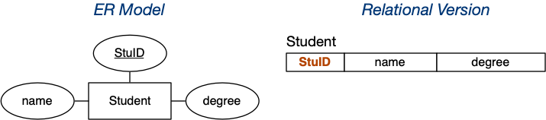
Mapping Strong Entities
An entity set E with atomic attributes a₁, a₂, ... a_{n} maps to A relation R with attributes (columns) a₁, a₂, ... a_{n}

Slide 4
Mapping Weak Entities
Figure out the weak entity types from the diagram and create a corresponding relation(table) that includes all its simple attributes.
Add as foreign key all of the primary key attributes in the entity corresponding to the owner entity.
The primary key is a combination of all the primary key attributes from the owner and the primary key of the weak entity.

Slide 5
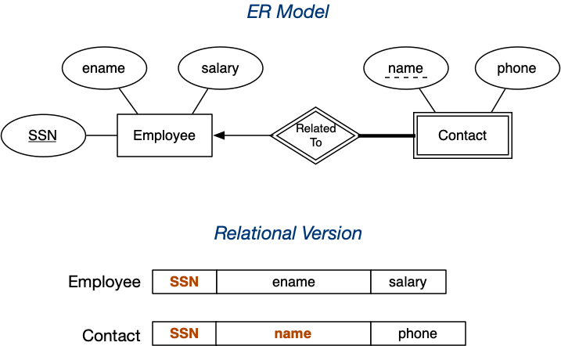
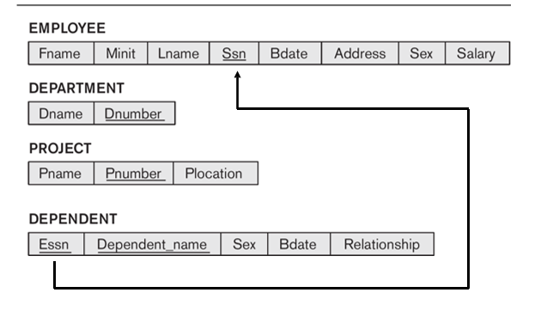

Slide 6
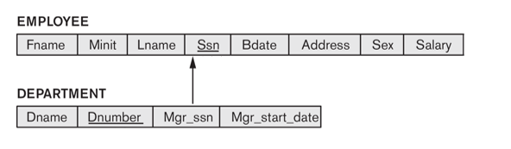
Mapping 1:1 Relationships
Now we need to figure out the entities from ER diagram for which there exists a 1-to-1 relationship.
The entities for which there exists a 1-to-1 relationship, choose one relation(table) as S, the other as T.
Better if S has total participation (reduces the number of NULL values).
Then we need to add to S all the simple attributes of the relationship if there exists any.
After that, we add as a foreign key in S the primary key attributes of T.

Slide 7
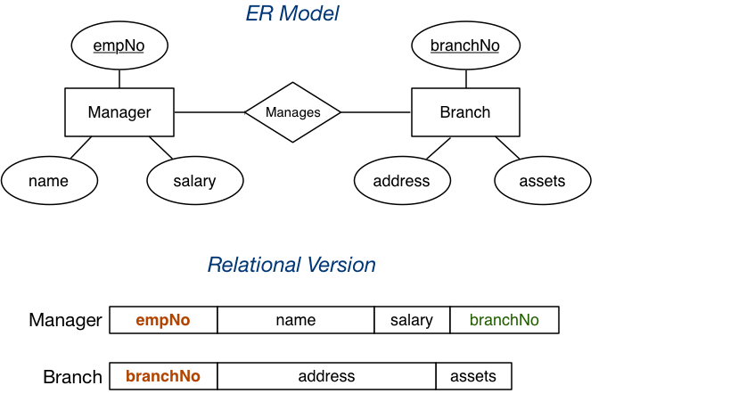
Mapping 1:1 Relationships
Binary Relationship with 1:1 cardinality with total participation of an entity.

Slide 8
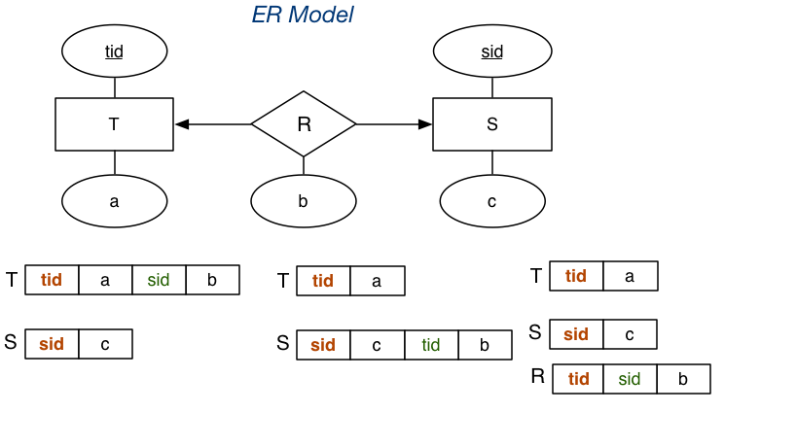
This mapping can also be converted into
Manager : empno, name, salary
Branch: Branchno, address, assests
Manage: empno, branchno
Another example:

Slide 9
Mapping 1:N Relationships
Now we need to figure out the entities from ER diagram for which there exists a 1-to-N relationship.
The entities for which there exists a 1-to-N relationship, choose a relation as S as the type at N-side of relationship and other as T.
Then we add as a foreign key to S all of the primary key attributes of T.

Slide 10
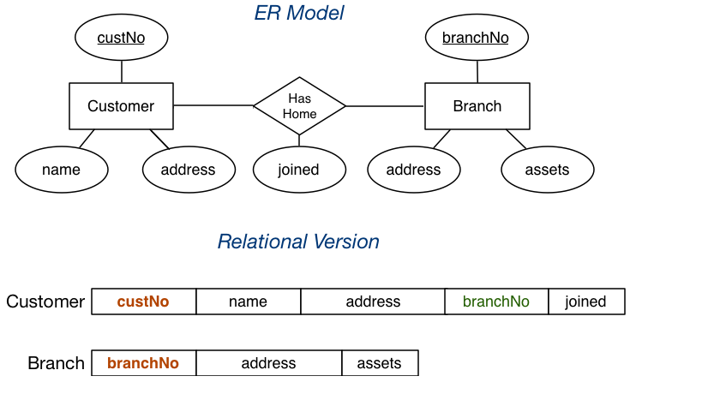
Mapping 1:N Relationships

Slide 11
Mapping N:M Relationships
Now we need to figure out the entities from ER diagram for which there exists an M-to-N relationship.
Create a new relation(table) S.
The primary keys of relations(tables) between which M-to-N relationship exists, are added to the new relation S created, that acts as a foreign key.
Then we, add any simple attributes of the M-to-N relationship to S.

Slide 12
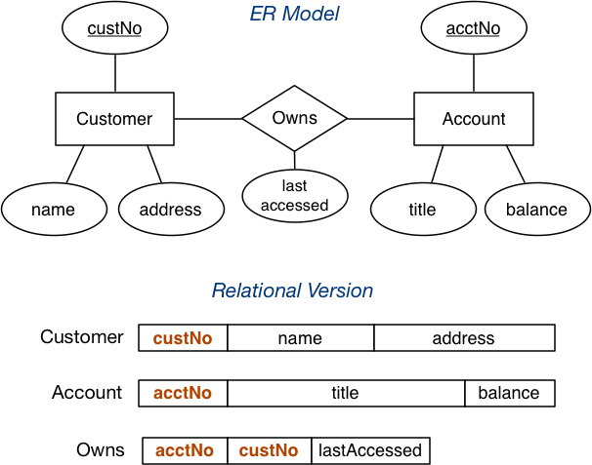
Mapping N:M Relationships

Slide 13
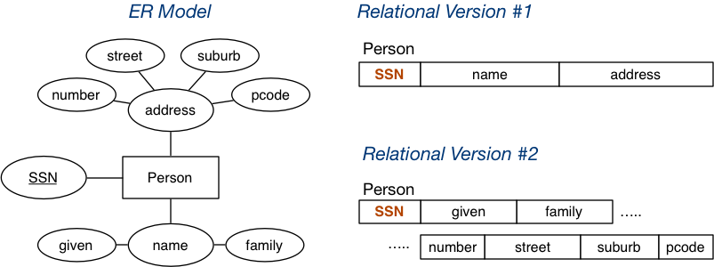
Mapping Composite Attributes
Composite attributes are mapped by concatenation or flattening.

Slide 14
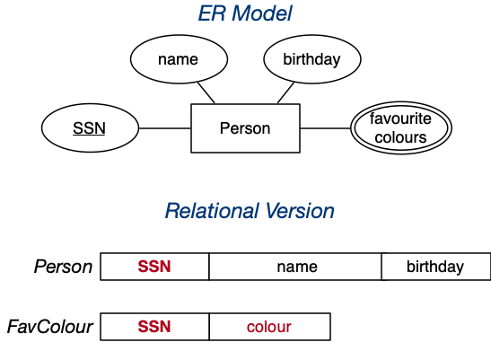
Mapping Multi-valued Attributes
Mapping Multi-valued Attributes (MVAs) are mapped by a new table linking values to their entity.

Slide 15
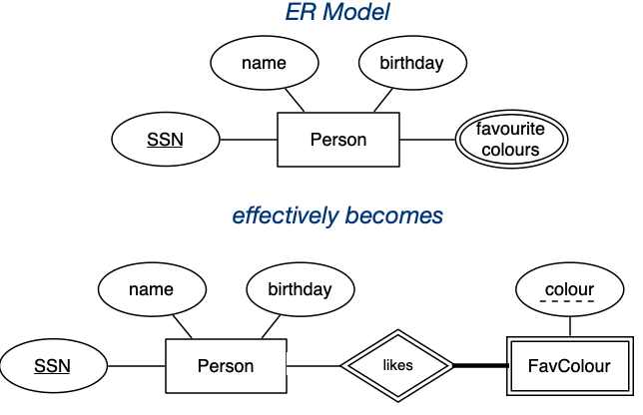
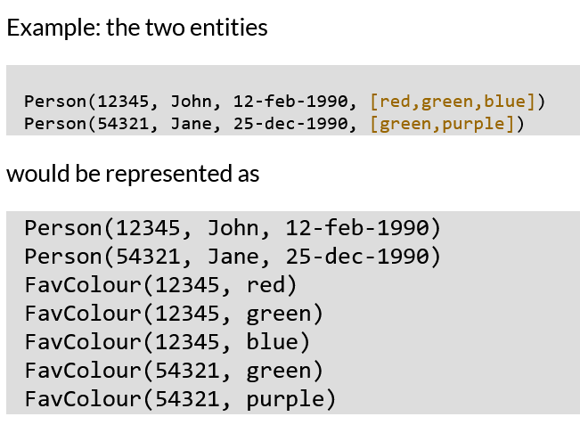

Slide 16
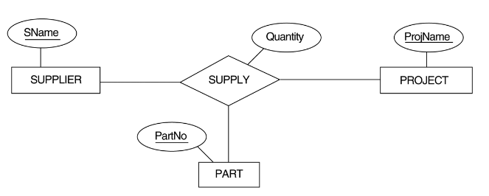
Mapping of N-ary Relationship
For each n-ary relationship type R, where n>2, create a new relationship S to represent R.
Include as foreign key attributes in S the primary keys of the relations that represent the participating entity types.
Also include any simple attributes of the n-ary relationship type (or simple components of composite attributes) as attributes of S.

Slide 17
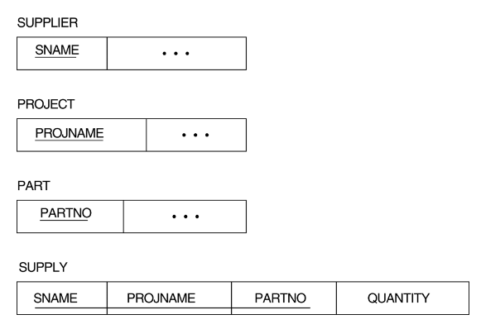

Slide 18
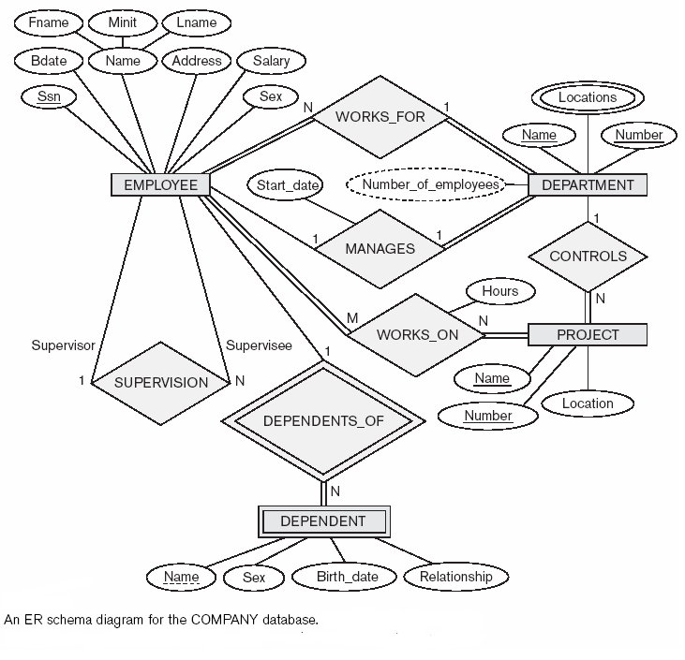

Slide 19
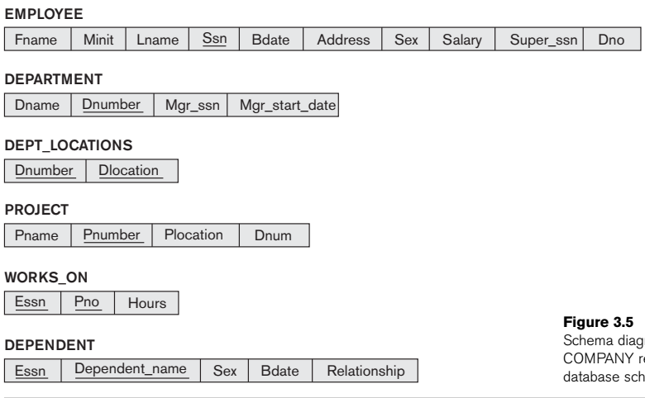

Slide 20
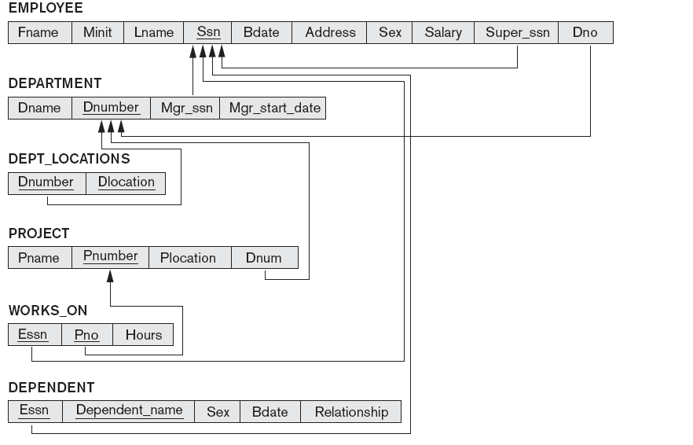

Slide 21
Options for Mapping Specialization or Generalization
Convert each specialization with m subclasses {S1, S2,…., Sm} and generalized superclass C, where the attributes of C are {k,a1,…an} and k is the (primary) key, into relational schemas using one of the four following options:
  A: Multiple relations-Superclass and subclasses
  B: Multiple relations-Subclass relations only
  C: Single relation with one type attribute
  D: Single relation with multiple type attributes

Slide 22
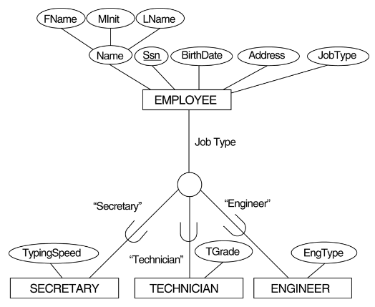
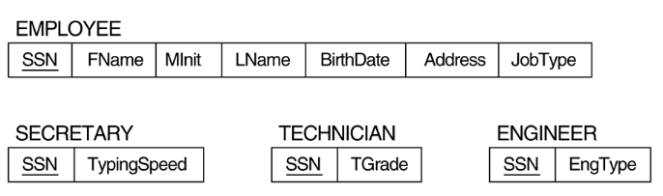
Multiple relations-Superclass and subclasses

Slide 23
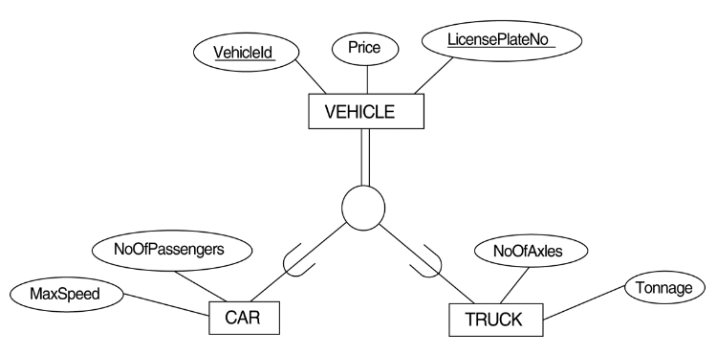
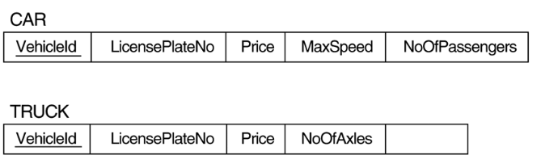
Multiple relations-Subclass relations only

Slide 24
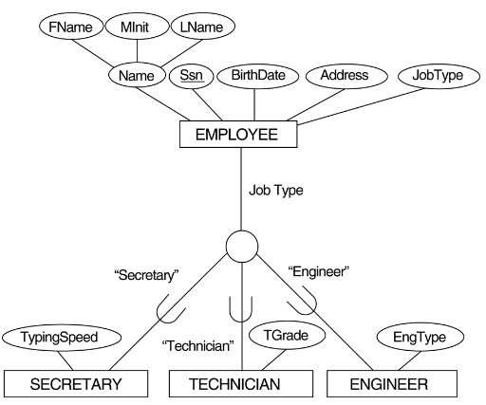

Single relation with one type attribute
Create a single relation L with attributes Attrs(L) = {k, a₁,…a_{n}} U {attributes of S₁} U…U {attributes of S_{m}} U {t} and PK(L) = k.
The attribute t is called a type (or discriminating) attribute that indicates the subclass to which each tuple belongs.

Slide 25
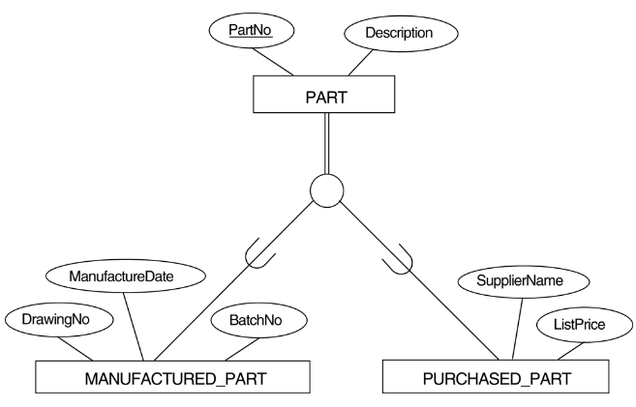

Single relation with multiple type attributes
Create a single relation schema L with attributes Attrs(L) = {k, a₁,…a_{n}} U {attributes of S₁} U…U {attributes of S_{m}} U {t₁, t₂,…,t_{m}} and PK(L) = k. Each t_{i}, 1 < I < m, is a Boolean type attribute indicating whether a tuple belongs to the subclass S_{i}.

Slide 26
Mapping of Shared Subclasses (Multiple Inheritance)
A shared subclass, such as STUDENT_ASSISTANT, is a subclass of several classes, indicating multiple inheritance.
These classes must all have the same key attribute; otherwise, the shared subclass would be modeled as a category.
We can apply any of the options discussed in Step a shared subclass, Below both C and D are used for the shared class STUDENT_ASSISTANT.

Slide 27
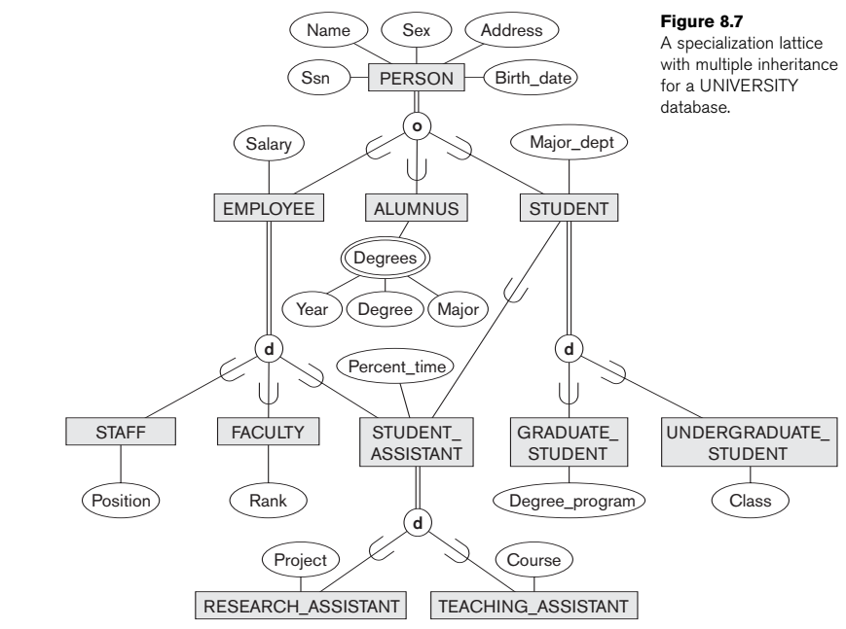

Slide 28
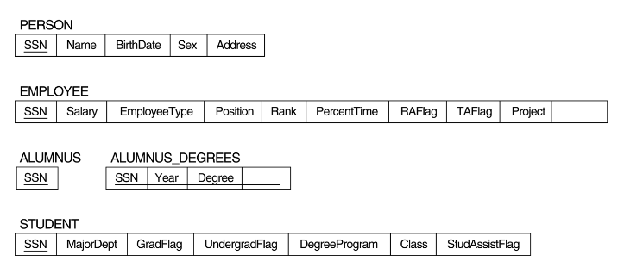

Slide 29
Mapping of Union Types (Categories).
For mapping a category whose defining superclass have different keys, it is customary to specify a new key attribute, called a surrogate key, when creating a relation to correspond to the category.
In the example below we can create a relation OWNER to correspond to the OWNER category and include any attributes of the category in this relation. The primary key of the OWNER relation is the surrogate key, which we called OwnerId.

Slide 30
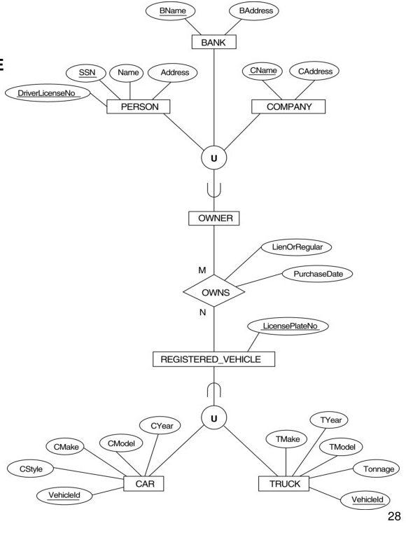

Slide 31
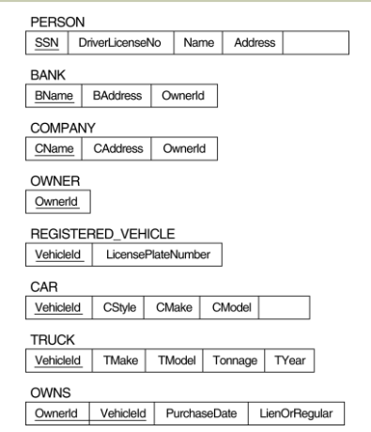

Slide 32
Mapping strong ET
EMPLOYEE(Fname, Minit, Lname, Ssn, Address, Bdate, Salary, Gender)
DEPARTMENT(Dname, Dnumber)
Dname is a secondary (Reference) key
PROJECT(Pname, Pnumber, Location)
Pname is a secondary key

Slide 33
Mapping weak ET & Identifying relationship type
DEPENDENT(Essn, Name, Gender, Bdate, Relationship)
Essn is a foreign key that refers to EMPLOYEE(Ssn)

Slide 34
Mapping one to one and one to many relationship types
EMPLOYEE(Fname, Minit, Lname, Ssn, Address, Bdate, Salary, Gender, Dno, Super_ssn)
Dno is a foreign key that refers to DEPARTMENT(Number)
Super_ssn is a foreign key that refers to EMPLOYEE(Ssn)
DEPARTMENT(Dname, Dnumber, Mgr_ssn, Mgr_start_date)
Mgr_ssn is a foreign key that refers to EMPLOYEE(Ssn)
PROJECT(Pname, Pnumber, Location, Dnum)
Pname is a secondary key,
Dnum is a foreign key that refers to DEPARTMENT(Dnumber)

Slide 35
Mapping many to many relationship type
WORKS_FOR(Essn, Pno, Hours)
Essn is a foreign key that refers to EMPLOYEE(Ssn)
Pno is a foreign key that refers to PROJECT(Pnumber)
Primary key(Essn, Pno)

Slide 36
Mapping multi valued attribute
DEPT_LOCATIONS(Dnumber, Dlocation)
Dnumber is a foreign key that refers to DEPARTMENT(Dnumber)
Primary key(Dnumber, Dlocation).

Slide 38
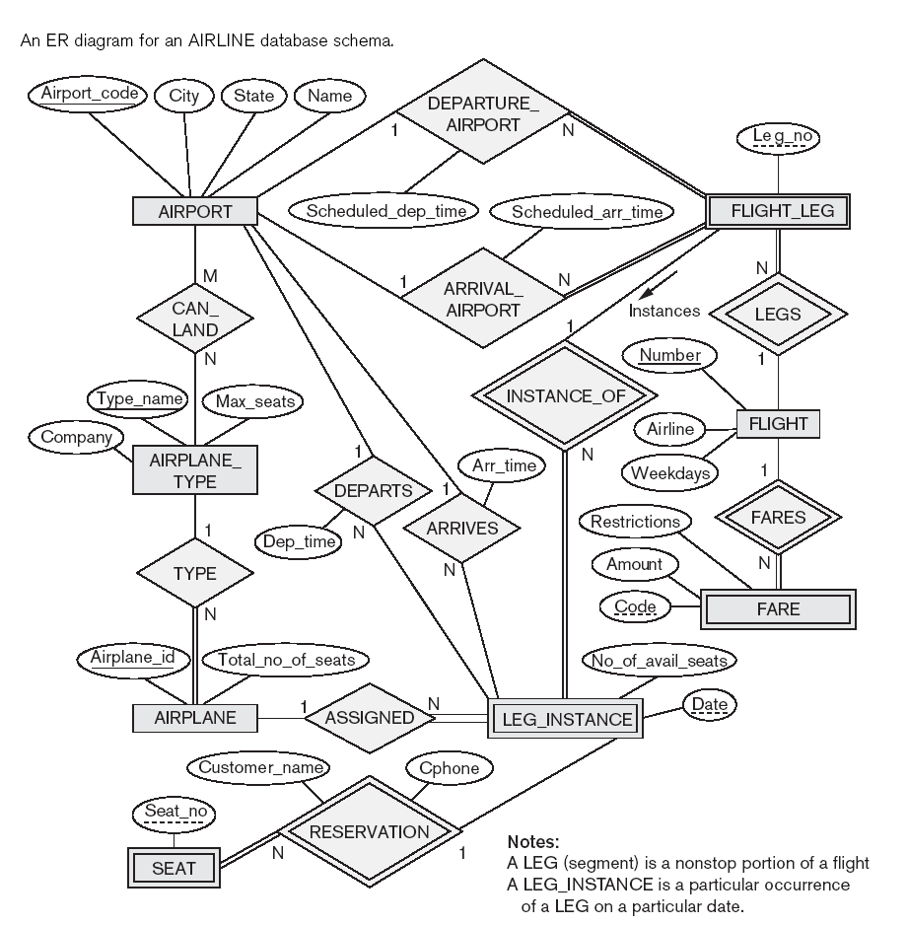

Slide 39
Map the strong entity types
AIRPORT(Airport_code, City, State, Name)
AIRPLANE_TYPE(Type_name, Company, Max_seats)
AIRPLANE(Airplane_id, Total_no_of_seats)
FLIGHT(Number, Airline, Weekdays)

Slide 40
Map weak entity types & identifying relationship types
FLIGHT_LEG(Leg_no, Scheduled_dep_time, Scheduled_arr_time, Flight_number)
Flight_number is a foreign key that refers to FLIGHT.Number
FARE(Code, Amount, Restrictions, Flight_number)
Flight_number is a foreign key that refers to FLIGHT.Number

Slide 41
Map weak entity types (contd.)
LEG_INSTANCE(Date, Number_of_avail_seats, Leg_no, Flight_number)
Flight_number is a foreign key that refers to FLIGHT(Number)
(Leg_no, Flight_number) is a foreign key that refers to FLIGHT_LEG (Leg_no, Flight_number)

Slide 42
Map weak entity types (contd.)
SEAT(Seat_no, Customer_name, Cphone, Date, Leg_no, Flight_number)
Flight_number is a foreign key that refers to FLIGHT(Flight_number)
(Leg_no, Flight_number) is a foreign key that refers to FLIGHT_LEG (Leg_no, Flight_number)

Slide 43
Map the relationship types
FLIGHT_LEG(Leg_no, Scheduled_dep_time, Scheduled_arr_time, Flight_number, Arrival_airport_code, Departure_airport_code)
Flight_number is a foreign key that refers to FLIGHT.Number
Arrival_airport_code, Departure_airport_code are foreign
keys each referring to AIRPORT.Airport_code.

Slide 44
Map the relationship types (contd.)
LEG_INSTANCE(Date, Number_of_avail_seats, Leg_no, Flight_number, Arrival_airport_code, Departure_airport_code, Airplane_code, Arr_time, Dep_time)
Flight_number is a foreign key that refers to FLIGHT(Number)
(Leg_no, Flight_number) is a foreign key that refers to
FLIGHT_LEG
Arrival_airport_code, Departure_airport_code are foreign
keys each referring to AIRPORT(Airport_code)
Airplane_code is foreign key that refers to
AIRPLANE(Airplane_code)

Slide 45
Map relationship types (contd.)
AIRPLANE(Airplane_id, Total_no_of_seats, Type_name)
Type_name is a foreign key that refers to AIRPLANE_TYPE(Type_name)
CAN_LAND(Type_name, Airport_code)
Type_name is a foreign key that refers to AIRPLANE_TYPE(Type_name)
Airport_code is a foreign key that refers to AIRPORT(Airport_code)

Slide 46
